Slide 1
Accelerating Matrix Products with Compute-Friendly Compression formats
Kevin Tenolli, Masters in computer science at the University of Vienna, Praktikum 1
Advisor: João Nuno Estevão Fidalgo Ferreira Alves
Notes:
What about: accelerating matrix products with compute-friendly compression formats.
“Increasing the speed of matrix operations by using sparse matrices” - this is not our objective, using sparse matrix formats is already the standard in the industry. What we want is to compress these matrices beyond what sparsity allows.
NEW: The title still needs to be fixed
Title could just be: Accelerating Matrix Products with Compute-Friendly Compression Formats.

Slide 2
Topic Introduction
Core problem: Graph algorithms are often bottlenecked by dot products involving their adjacency(binary) matrices.
Bottlenecks:
Dense multiplication → Impractical for large graphs
Different representations (CSR) speed up this process but it can be better
Goal: Implementing Compute-friendly Compression formats that leverage HPC libraries:
Intel MKL (CPU)
NVIDIA cuSPARSE (GPU)
Compare the results of this implementations against CBM format
Notes:
This sentence is more accurate -> “Core problem: Graph algorithms are often bottlenecked by matrix products involving their (binary) adjacency matrix.”
Why not talk about the related work already here? (CBM, STAF, and BEM)
NEW:
For better aesthetics, try to make the first sentence fit in a single line. You might have to rewrite it.
Goal: Implementing Compute-friendly Compression format that leverage HPC libraries:
Intel MKL on CPU
NVIDIA cuSPARSE on GPU

Slide 3
Related work
The goal is achieve a sizeable speedup of matrix operations for large datasets using different compression formats to have a performant CSR representation of the matrix, as well as accelerating calculations using IntelMKL and cuSPARSE.
[M. Nishino, 2014] - introduced the Single Tree Adjacency Forest (STAF):
➢ Represents shared row suffixes once, re-uses dot products involving shared suffixes
[A. Francisco, 2017] - introduced the Biclique Extraction method (BEm):
➢ Compression by extracting maximal bicliques, Re-uses inner-products involving shared bicliques
[João N. F. Alves, 2024] - introduced the Compressed Binary Matrix (CBM) format:
➢ Only stores differences between similar rows, uses differences to re-use previous dot-products.
Notes:
NEW:
You already stated the goal before, no need to have it here.
This slide isn’t very accurate. Instead use:
Represents shared row suffixes once, re-uses dot products involving shared suffixes
Second one is okay.
Only stores differences between similar rows, uses differences to re-use previous dot-products.

Slide 4
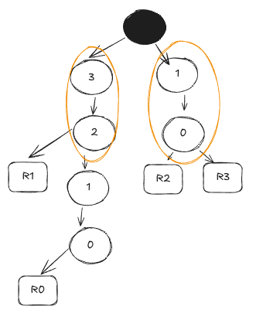
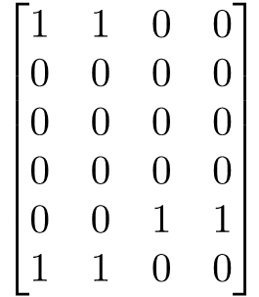
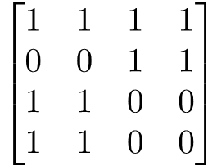

Intuition - Compression with STAF
Given a matrix, the goal is to find the shared suffixes between rows.
Allows for shared patterns to be reduced from rows → Shared suffixes are presented only once
Notes:
The maps that connect suffixes to rows should be in the third picture, as they are not needed for the STAF.
Maybe you could just have some arrows going from S1 and S2 in the third picture, that point to the rows where they are needed.
Note that the third picture is our contribution, therefore it should be marked as so, or you could also say it during the presentation.
Given a matrix, the goal is to find the shared indices between rows. -> find shared patterns (in this case suffixes)...
Allows for shared patterns to be reduced from rows, giving a sparse representation. -> Allows shared suffixes to be represented only once. (and in the presentation you should say that this is what allows us to reduced the memory footprint of the matrix beyond what sparsity allows).
I think you should have another slide with the matrix multiplication using STAF. There you could explain where Intel MKL and CuSPARSE come in.
I think it would be a good idea to end the presentation with this slide and an intuition about matrix multiplication with the format.

Slide 5

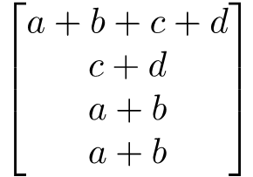
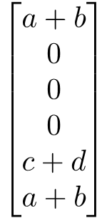
Sparse Formats vs STAFF + Intel MKL/cuSPARSE
Total ops: 10 (mult) + 6 (add) = 16
Total ops:
6 (mult) + 3 (add) = 9
Notes:
In this slide you should also show the matrix multiplication with the original matix and show the number of scalar operations required, otherwise the benefits of matmul with STAF are not immediately clear.
If you have time please try to improve the way this slide looks: Make sure everything has the same font, and try to reduce the size of the figures a bit so you dont have to “stretch” them. Instead of copy pasting these matrices from somewhere else, you could just use text boxes, and the shapes offered by google slides (Insert > Shape > Equation)

